Slide 1
Writing Chemical and Molecular Equations

Slide 2
By the end of this lesson, you should be able to:
• | Understand that chemical equations and molecular equations show how atoms are rearranged during chemical reactions.
• | Determine the correct chemical equation that represents a chemical reaction.
• | Determine the correct molecular equation that represents a chemical reaction.

Slide 3
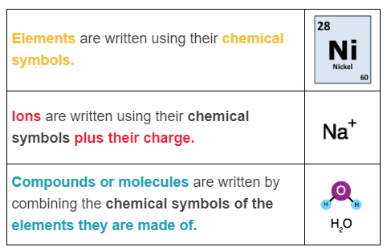
In chemical equations, substances are represented by their chemical formula.
This is written using chemical symbols. Let's quickly recap the key information on the use of chemical symbols:

Slide 4

An element's chemical symbol is found on the Periodic Table.
For example, on the periodic table the symbol for neon is Ne.

Slide 5

Sometimes you can work out the chemical symbol of a compound by using its name.
For example sodium chloride (table salt) is made of the elements sodium (Na) and chlorine (Cl). Its chemical symbol is thus NaCl.

Slide 6
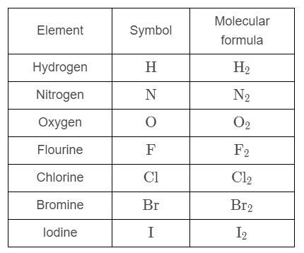
The Diatomic Elements are 7 elements from the periodic table that never want to be alone.
Instead, their atoms bond in pairs, forming diatomic molecules.
(Diatomic means "two atoms.")

Slide 7


Chemists place small numbers (called subscripts) after a chemical symbol to show how many of each type of atom there are in the molecule.
In the chemical symbol O₂​, the small 2 indicates there are two atoms of oxygen.
If there is no subscript after a symbol it is assumed there is only one atom of that element.
For example, carbon dioxide is composed of one carbon (C) atom and two oxygen atoms (O). It is thus written as CO_{2​}. Technically, we could write it as C₁​O₂​, but writing the 1 is redundant so we leave it out.

Slide 8
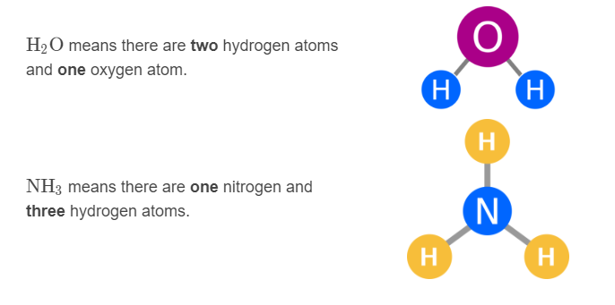
Here are some more examples of how to use subscripts.

Slide 9
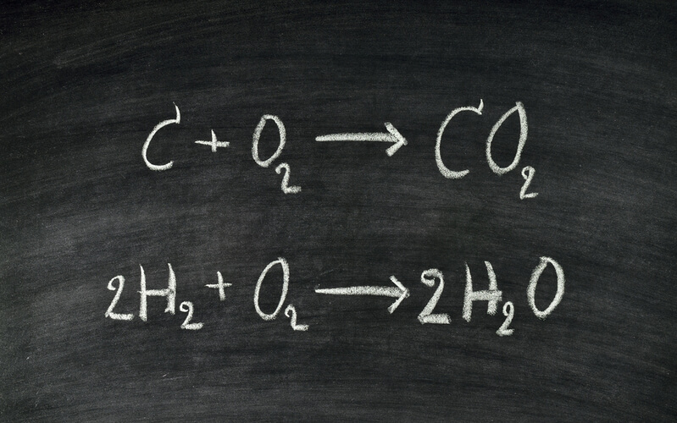
Chemical equations are just like word equations, except they use the reactants' and products' chemical symbols instead of their names.
To make writing chemical equations easier, first write out the word equation.
Then replace the names of the chemicals with their chemical symbols.

Slide 10
Here is an example:
Sulfur dioxide can break down into sulfur and oxygen.
Sulfur dioxide is the reactant and the products are sulfur and oxygen.
Now that we have identified the reactants and products, we can write the word equation:

Slide 11
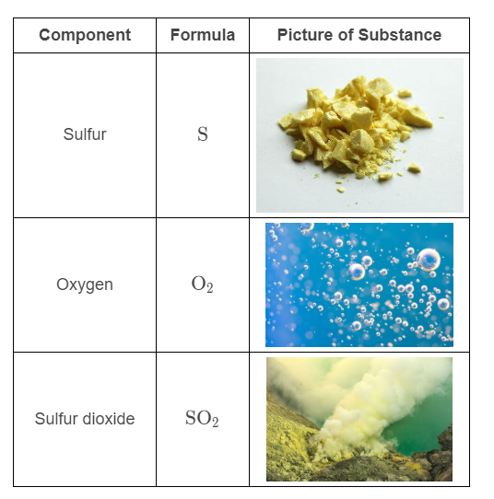
Here are the chemical symbols:

Slide 12

Now, let us insert these symbols into our word equation.
Here is our word equation again:
Replacing sulfur dioxide with SO₂​, sulfur with S and oxygen with O₂​ produced the following chemical equation:

Slide 13
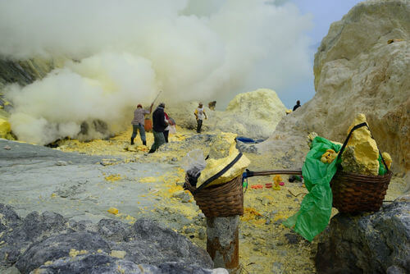
When writing chemical equations, we sometimes add letters in brackets next to the reactants and products.
These represent the state of the substance (liquid, solid or gas).
These represent the state of the substance (liquid, solid or gas).

Slide 14
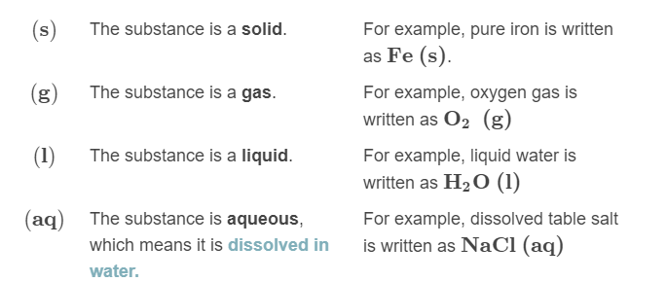
The letter in the brackets represents the phase of the reactant or product:

Slide 15
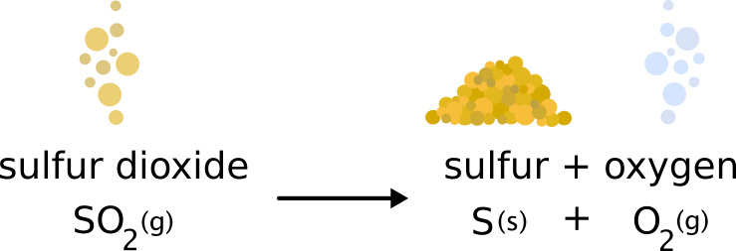
Chemical equations are useful because they give us more information than word equations.
By showing what atoms make up what substances, we can see how the atoms were rearranged during the reaction.
They can also show us what phase the reactants and products are in.

Slide 16
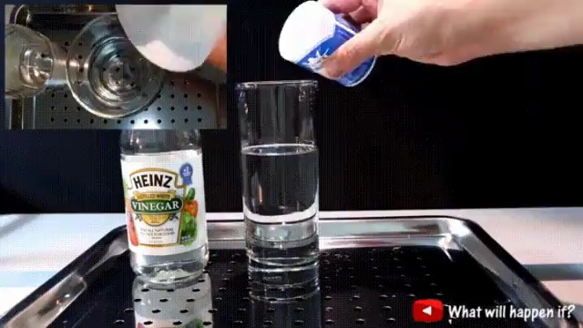
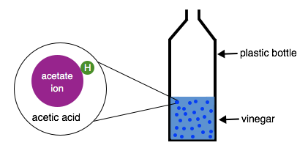
Each chemical equation represents the smallest unit of the chemical reaction.
You may have seen the reaction that occurs when baking soda is added to vinegar. If not, it looks like this:
You might have added millions of molecules of sodium bicarbonate (baking soda) to hundreds of thousands of molecules of acetic acid (vinegar) in your bottle. However, a formula equation represents what happens to one molecule of sodium bicarbonate and one molecule of acetic acid.

Slide 17
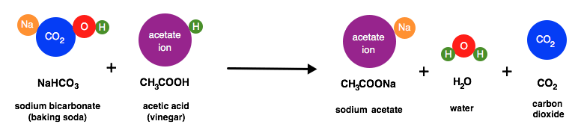
It might seem strange that the chemical equation seems to show what happens to one molecule of vinegar and baking soda.
It is shown like this because it is much simpler to see how the atoms are rearranging - but remember that it represents what is happening to all of the atoms in the vinegar solution.

Slide 18
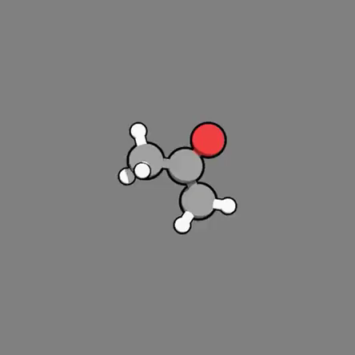
The third type of chemical equation is molecular equations.
These are similar to chemical equations. chemical equations describe what atoms are in the reactants and products, and thus give information about their molecular structure.
In a molecular equation, we convert this information into pictures. This makes it easier to see how atoms are rearranged during a chemical reaction.

Slide 19
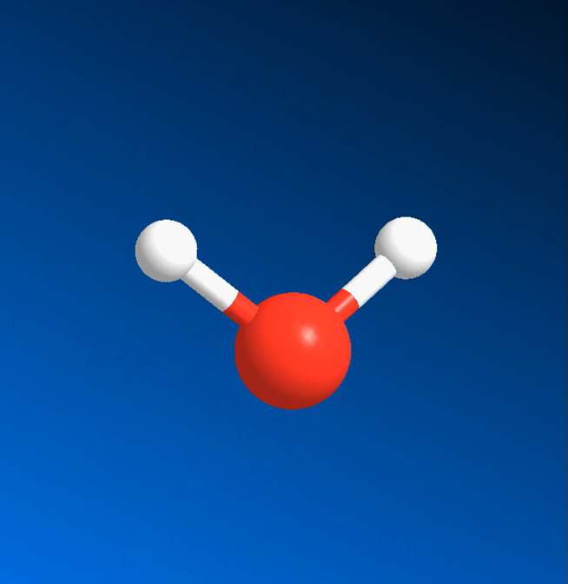
Before learning how to write molecular equations, you need to know how to draw and read molecular structures.

Slide 20

Here is a picture of the molecular structure of a chlorine molecule:
See how it is composed of two chlorine (Cl) atoms, depicted as circles? The bar connecting the atoms shows that they are bonded to one another.
Now compare this picture to the chemical formula for chlorine: Cl₂​. See how the chemical formula also states that there are two chlorine atoms? We then assume they are bonded to one another.
So the picture and the formula both describe the atoms present in chlorine, but only the picture explicitly shows how the atoms are bonded.

Slide 21
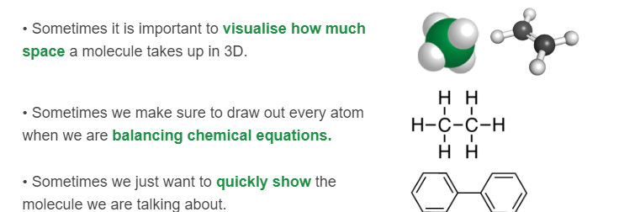
Scientists can draw molecules in many different ways and different types of pictures are useful in different situations:

Slide 22
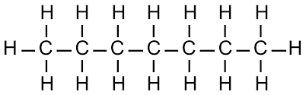
The easiest way to draw molecules on paper is to draw the structural formula.
This is when we write out the chemical symbols of each atom and join them with a dash to represent a bond.
Drawing the structural formula helps us know the physical arrangement of the atoms, especially if we don't know the name of the molecule.

Slide 23
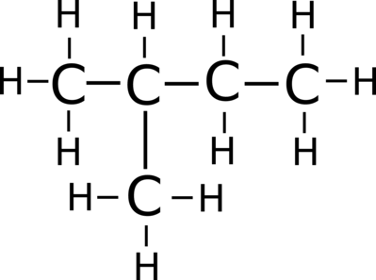
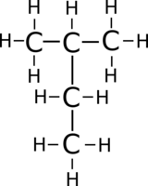
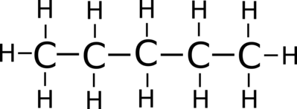
Chemists don't just draw the molecular structure because it looks pretty.
It is sometimes very important as different molecules can have the same chemical formula. For example, these three different molecules all have the same chemical formula C₅​H₁₂​:

Slide 24
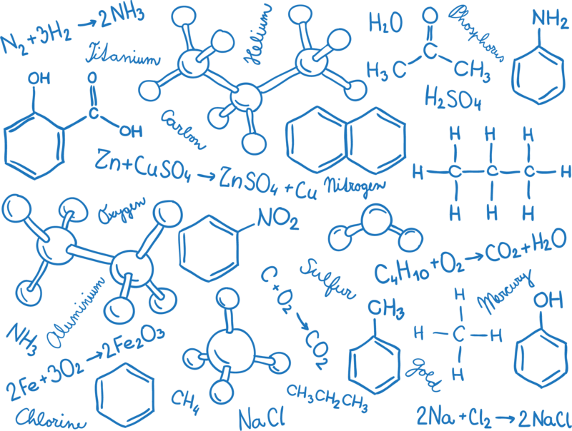
Now that you know how to draw and read molecular diagrams, we can make molecular equations.

Slide 25

You are already familiar with oxygen:
We have discussed oxygen before when learning how to write the chemical equation for the breakdown of sulfur dioxide (SO_{2​}).
Now, let us convert that chemical equation into a molecular equation.

Slide 26
First, we need to understand how the atoms are arranged before and after the reaction.
Remember, sulfur dioxide breaks down into sulfur and oxygen gas.
The formula for sulfur dioxide is SO_{2​}. This shows that sulfur dioxide is composed of one sulfur atom and two oxygen atoms. The oxygen atoms are both bound to the sulfur.
Sulfur (S) is made of a solitary sulfur atom. Oxygen or dioxide (O₂​) is made of two oxygen atoms bonded to one another.

Slide 27
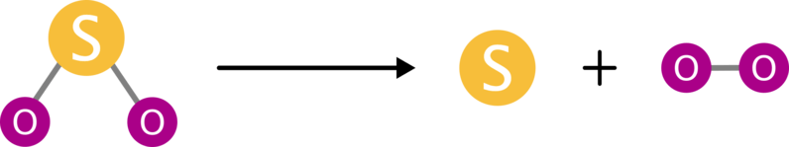
We can then take the chemical equation we worked out earlier...
...and replace the formulas with pictures of molecular structure to get our molecular equation:

Slide 28
When drawn like this it is easy to see how the atoms are rearranged during the chemical reaction:
• The bonds break between the sulfur atom and the oxygen atoms, destroying the sulfur oxide.
• A bond forms between the two oxygen atoms, creating diatomic oxygen gas.
• Sulfur is stable on its own as solid elemental sulfur.

